Slide 1
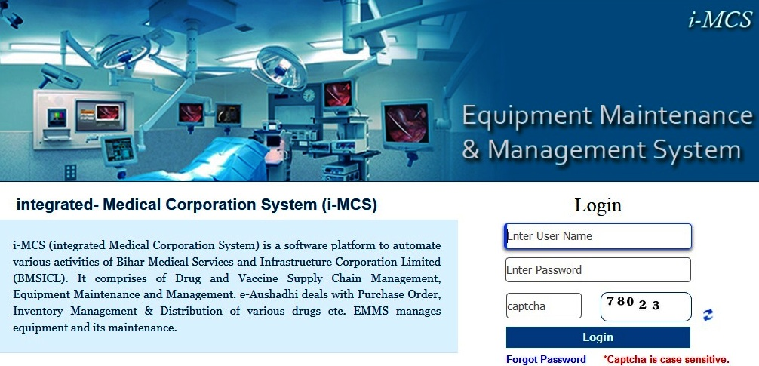
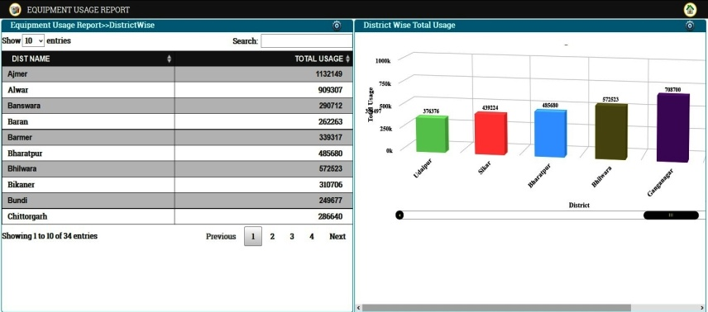
e-Upkaran
(Equipment Management & Maintenance System)
e-Upkaran, is C-DAC’s Equipment Management and Maintenance System for biomedical equipments in hospitals. The system ensures that these equipments remain safe for its intended use, the operational life is maximized and lifetime costs is minimized.
KEY FEATURES
Real time equipment status monitoring
Complaint monitoring and management
Preventive maintenance service monitoring
Centralized workshop monitoring
Configurable for multiple Laboratories
GIS based reporting
OBJECTIVES
Capture demand of new equipments,
Generate their purchase order,
Receive and install the equipment at site,
Monitor their daily usage,
Manage all stages of equipment maintenance and
Finally disposal of the equipment when condemned
IMPLEMENTATIONS
Rajasthan | Gujarat | Telangana | Jammu & Kashmir | Bihar | Madhya Pradesh | Punjab | Odisha | Tamil Nadu | IMS-Andhra Pradesh | Jharkhand | Nagaland

Slide 2
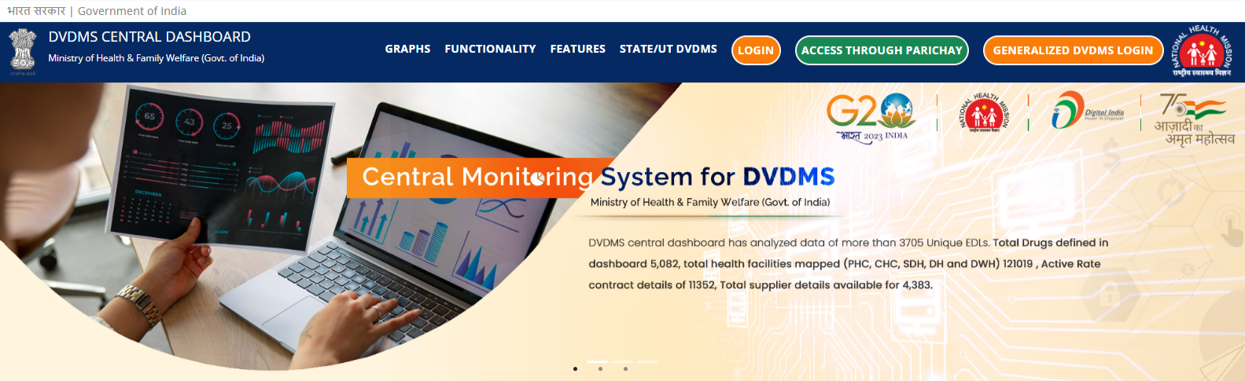
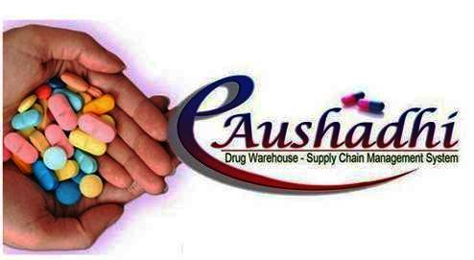
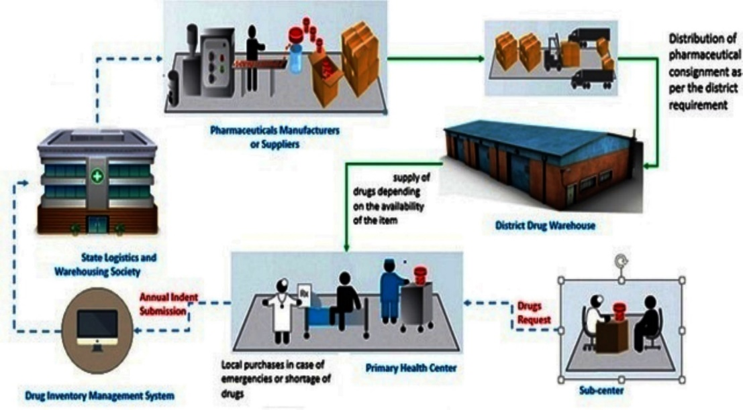
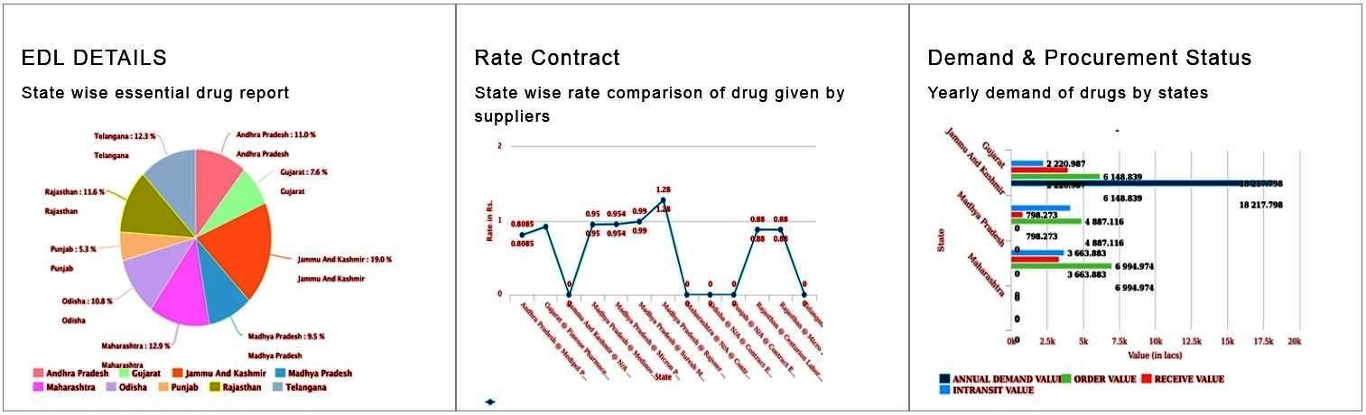
e-Aushadhi
(Drug & Vaccine Distribution Management System)
e-Aushadhi is a web based Supply Chain Management System that deals in purchase, supply, distribution and inventory management of various drugs, sutures, surgical and consumable items by linking various Regional/ District Drug warehouses (DWH), District Hospitals (DH), their sub stores like Community Health Centre (CHC), Primary Health Centre (PHC) and Sub Centres. The system also has the functionality for distribution of drugs to patients, thus enabling tracking of consumption till last mile.
KEY FEATURES
Web based on Open Source Platform
Alert Management System
Centralised Dashboard
Dynamic Reporting and Data Analysis
Online/Offline Drug Distribution Counters
GS1 Compliant Barcode Interface
Integration with payment gateway and SMS gateway
Integration with digital signature
Secured and configurable architecture
IMPLEMENTATIONS
STATES & UT : Rajasthan | Gujarat | Telangana | Jammu & Kashmir | Bihar | Madhya Pradesh | Maharashtra | Punjab | Andhra Pradesh | Uttar Pradesh | Uttarakhand | Manipur | Himachal Pradesh | Jharkhand | Meghalaya | Assam | Arunachal Pradesh | Mizoram | Nagaland | Odisha | Sikkim | UT (Puducherry & Lakshadweep)
NATIONAL PROGRAM : Central Dash Board-MoHFW | TB-MoHFW | FP-MoHFW | CMSS-MoHFW | MSO-MoHFW | DGAFMS-MoD

Slide 3


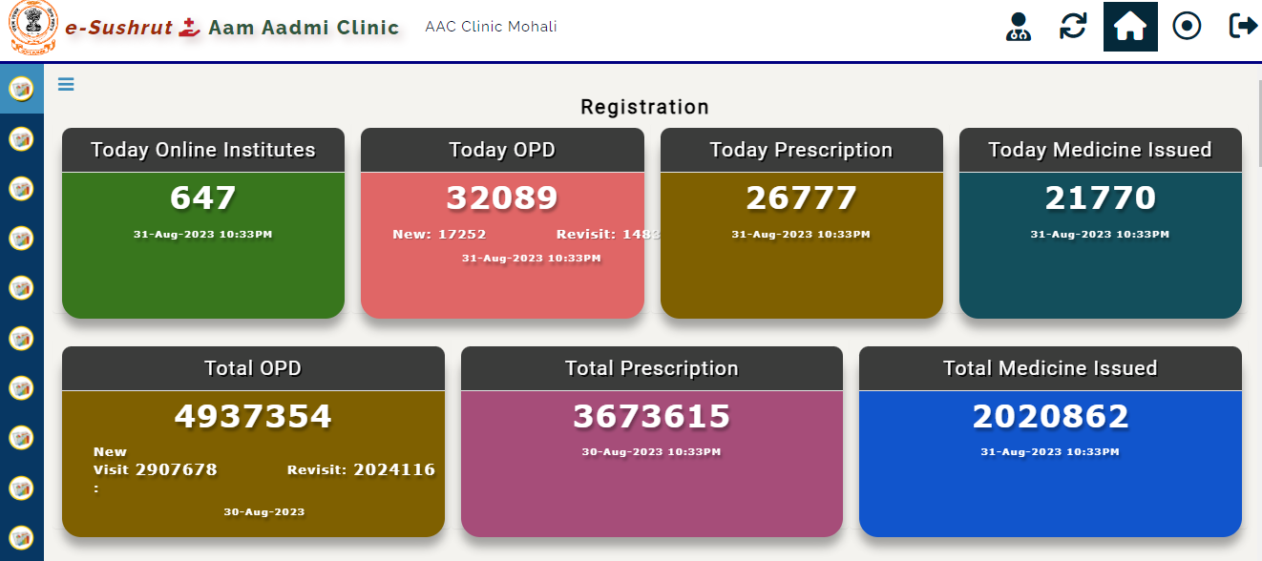
e-Sushrut Clinic
(Saas Based Solution)
e-Sushrut Clinic is A SaaS Based Solution to Clinics, Nursing Homes, Pharmacies & Labs.
KEY FEATURES
Patient Registration
Appointment Management
Queue Management
Communication Management
OP Billing
Role-Based Access
Patient Portal
Mobile App
Multilingual Support
Electronic Health Records
Pharmacy Management
Laboratory Management
Multi-location Support
Analytics and Report
USP
Seamless Configuration & Smooth Onboarding
ABDM and Health Standards
Mobile-Friendly
Secure Data
Scalability
Success Stories/Client Names (noteworthy deployments)

